Slide 1

FitForm: Proof of Concept
Exercise Posture Correctness Checker

Slide 2
Problem
Many individuals perform exercises without learning proper form
Risks of injury
Inefficient

Slide 3
Project Pitch
Generalized Portable Solution
Statistical Tracking
Real-Time Feedback

Slide 4
Project Uncertainties
Wearability and Comfortability
Accuracy of Correctness

Slide 5
Our Approach

Slide 6

Assumptions
An in-app manual explaining how to do exercise.
FitForm checks for slight imperfections in form.

Slide 7
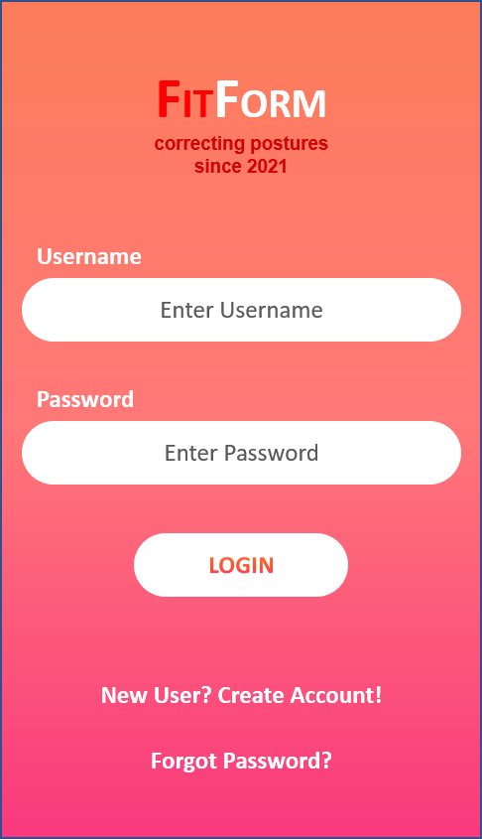
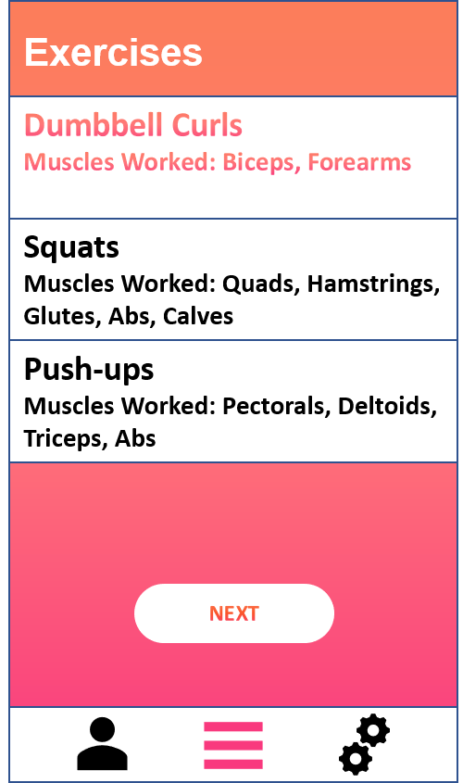
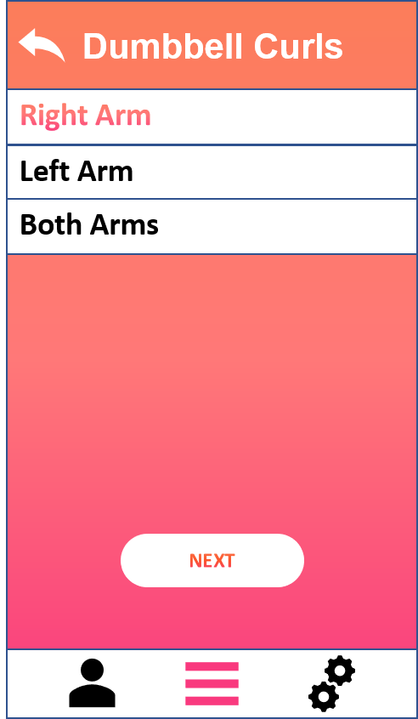
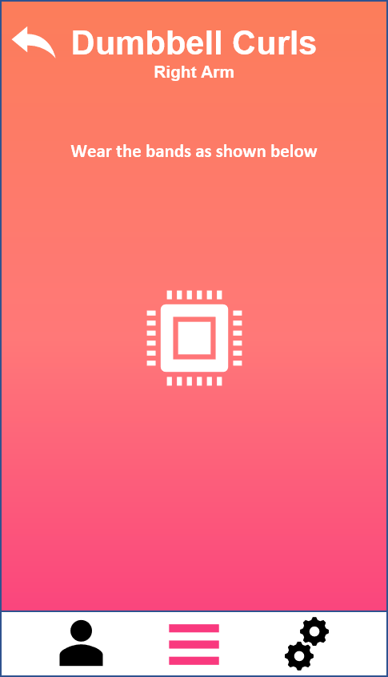
An Example User Interface

Slide 8
Process
Select an Exercise:
Dumbbell Curl
Left Arm, Right Arm or Both?
Check if sensor(s) are on wrists
Start exercise
Push-up
Check if sensor is on chest
Check if bands are on biceps
Start exercise
Squat
Check if sensors are on thighs
Start exercise

Slide 9
AN Example: Correct Bicep Curl Form - INSTRUCTIONS
Stand with your feet hip-width apart with a dumbbell in each hand. Bend your knees slightly, engage your core and maintain good upright posture.
Position your arms so that your palms are facing forward. Hold onto the dumbbells, but don't grip them so tightly that you feel strain in your forearms.
Bending at the elbow, lift both dumbbells up toward your shoulders by flexing your bicep muscles. Lower the dumbbells the same way you raised them until your arms are fully extended in the same position you started in.
Repeat eight to 12 repetitions without swinging your weights. In other words, rely on your muscles rather than momentum. If you find yourself needing to add momentum to lift, try using a slightly lighter dumbbell instead, as swinging can lead to injury.

Slide 10
Expected Hardware Inventory
Hardware | Part | Source (if needed) / Cost, etc.
Controller | Arduino or Raspberry Pi for prototyping. ATMEGA32 for compact final version. | Some members already own. https://www.buyapi.ca/product/raspberry-pi-400-complete-kit/?src=raspberrypi https://www.microchip.com/wwwproducts/en/ATmega32
Accelerometers | MPU6050 ADXL345 | https://www.amazon.com/HiLetgo-MPU-6050-Accelerometer-Gyroscope-Converter/dp/B00LP25V1A/ref=sr_1_3?dchild=1&keywords=Arduino+Accelerometer&qid=1605734531&sr=8-3
Communication Device | (bluetooth chip, wifi chip) | https://www.lairdconnect.com/wireless-modules/bluetooth-modules
3D Printed Materials | Printer: Prusa i3 MK3 Filament: PLA STL: Modified Thingiverse file or TinkerCAD | Already have a printer/filament. Estimated filament cost: <$10 https://www.thingiverse.com/thing:1264391 https://www.tinkercad.com/

Slide 11
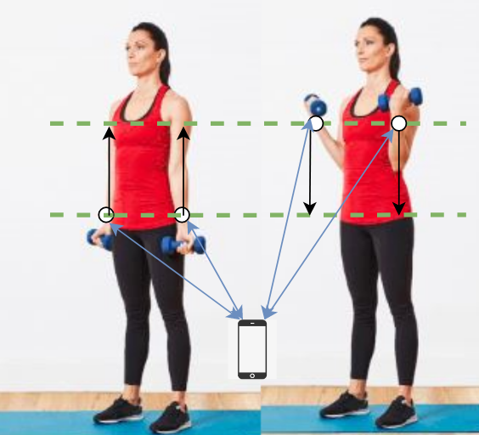
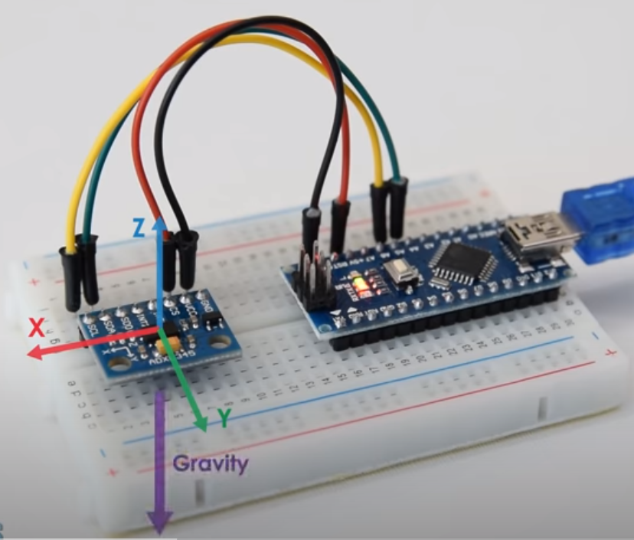
Device At Work

Slide 12
References
How To Track Orientation with Arduino | ADXL345 Accelerometer Tutorial
https://www.youtube.com/watch?v=KMhbV1p3MWk&ab_channel=HowToMechatronics
https://howtomechatronics.com/tutorials/arduino/how-to-track-orientation-with-arduino-and-adxl345-accelerometer/
How to Do a Proper Dumbbell Curl
https://www.livestrong.com/article/432105-how-to-do-a-proper-dumbbell-curl/
How to Get More From Your Bicep Curls
https://www.menshealth.com/uk/building-muscle/a748583/dumbbell-bicep-curls/

Slide 13
Demonstration

